Slide 1
Bill Easy-Your One-stop Invoicing Solution
The Only Billing Software you Need

Slide 2
Table Of Contents
Overview
Understanding the problems
Project objective
Target audience

Slide 3
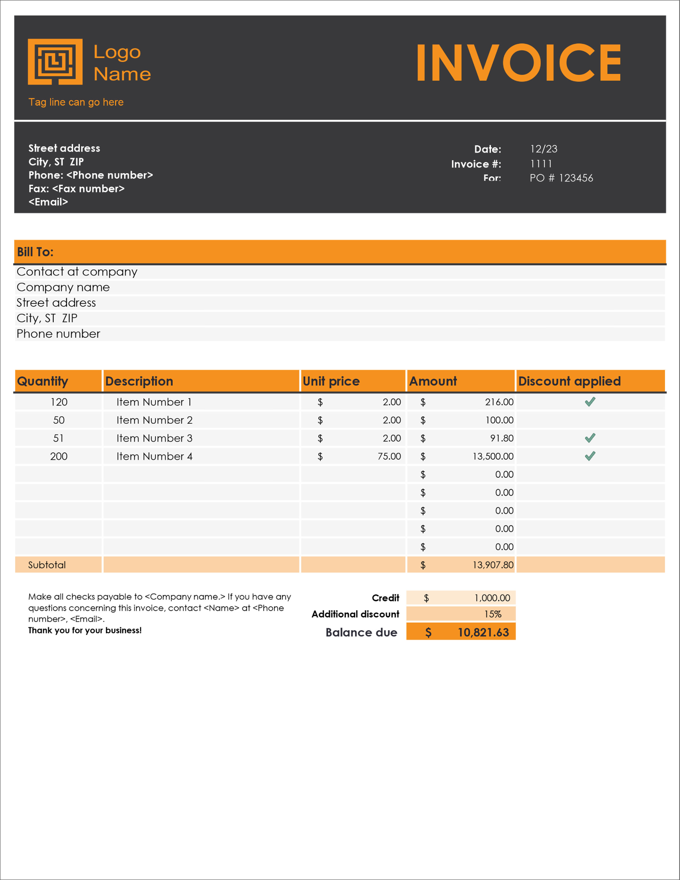
Overview
Bill easy is a dynamic Billing/Invoicing software built to simplify and streamline the invoicing and billing processes for businesses, making it easier and more efficient for them to manage their financial transactions.
Our startup aims to help businesses save time and reduce manual effort by automating various aspects of billing, including invoice generation, payment processing, and record-keeping.

Slide 4

Providing customizable invoicing templates and features allowing businesses to tailor the software to their specific needs and branding is our main goal.
Ensuring the security of financial and customer data is a top priority. Our startup aims to protect sensitive information from unauthorized access and data breaches.

Slide 5
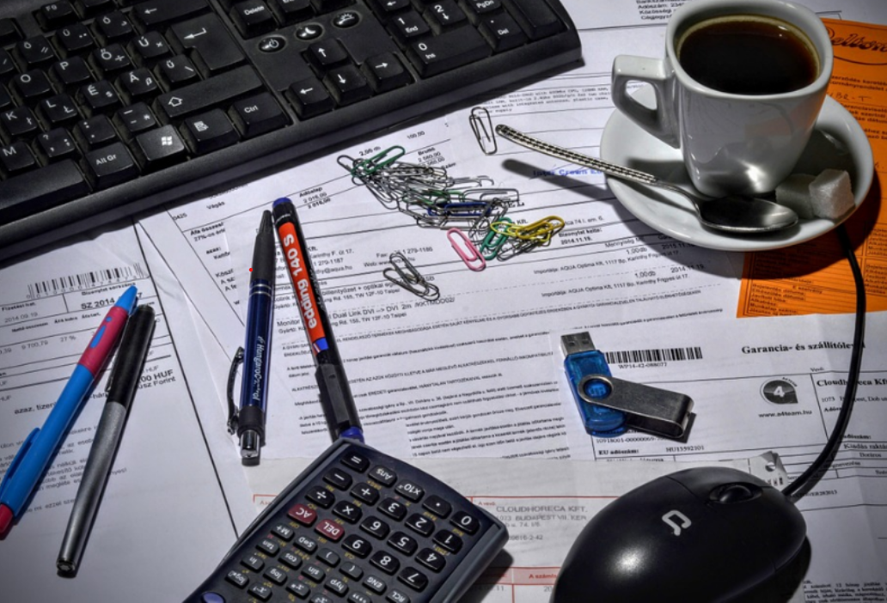
Understanding the problems
The government sector in India faced several challenges and issues with its billing systems-
01
Overdependence on Manual Billing:Many government agencies still rely on manual billing processes, including paper-based invoices and manual data entry. This can lead to errors, inefficiencies, and delays.
02
Most government billing systems may not be integrated with other government databases or systems, leading to redundant data entry, delays in information sharing, and potential data inconsistencies.

Slide 6

Data security issues and Lack of Transparency:Government billing systems often contain sensitive personal and financial information. Ensuring data security and privacy is a critical concern, and any breach can have serious consequences.
03
Audit and Accountability:Auditing and tracking financial transactions can be complex, leading to potential misuse of funds.
04
05
Archaic Systems: Some government agencies still use outdated billing software and technology, which can be inefficient and costly to maintain.

Slide 7
Project objective
The Prime objective of the Bill Easy platform is to make the process of invoicing simple and easy.
Invoice Generation: Our system allow users to create professional invoices easily. This includes customizable templates with company logos, contact details, and invoice numbering.
Recurring Billing: The recurring billing feature automates the creation and sending of invoices for regular subscriptions or services, saving time and ensuring timely payments.

Slide 8
Multiple Payment Options: A good billing system should support various payment methods, including credit cards, bank transfers, and digital wallets, to accommodate customer preferences.
Automatic Tax Calculation: It should calculate taxes (e.g., GST, VAT) accurately based on the products or services provided and the applicable tax rates.
Financial Reporting: Robust reporting capabilities provide insights into your business's financial health, including profit and loss statements, balance sheets, and cash flow statements.

Slide 9
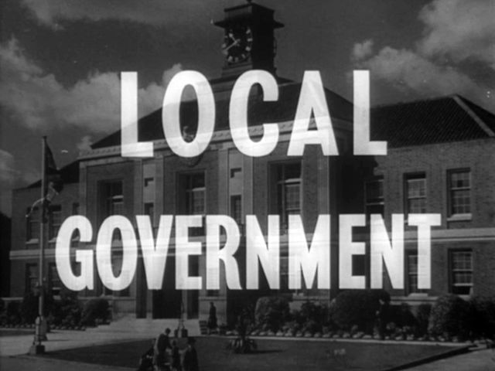
Target audience
Since our Software is solely intended for government use our clients include-
Local Municipalities and City Governments
Towns, cities, and municipalities use government billing software for utilities billing (water, sewer, garbage), property taxes, parking fines, permits, and licensing fees.Our software will prove to be very helpful for such institutions

Slide 10
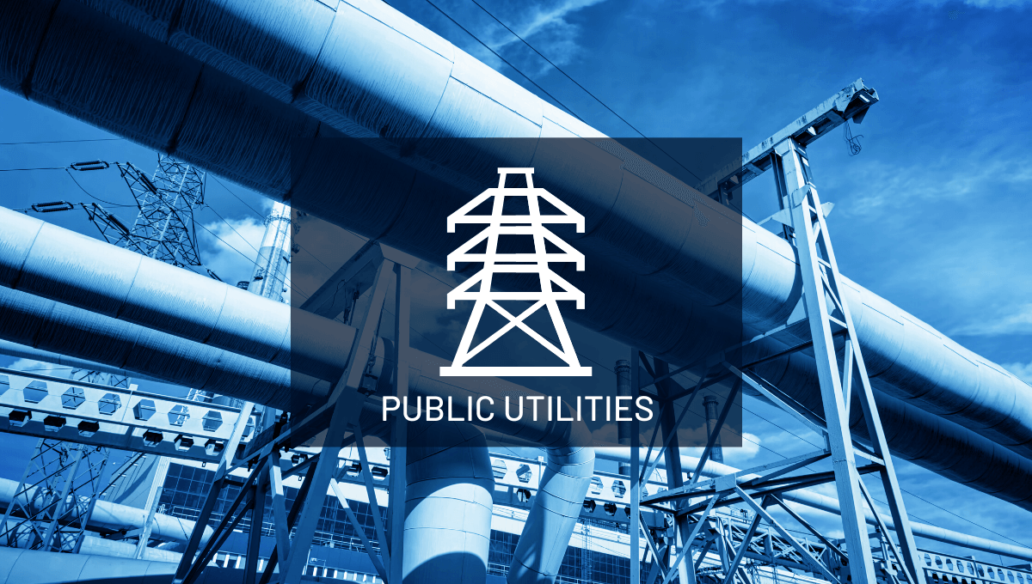

Public Utilities
Public utility companies owned or operated by government entities, such as water, gas, or electricity providers, will use our billing software to manage customer accounts and billing.
Public Health Departments
Health departments will be using our billing software for services such as immunizations, health inspections, and the collection of public health-related fees.

Slide 11

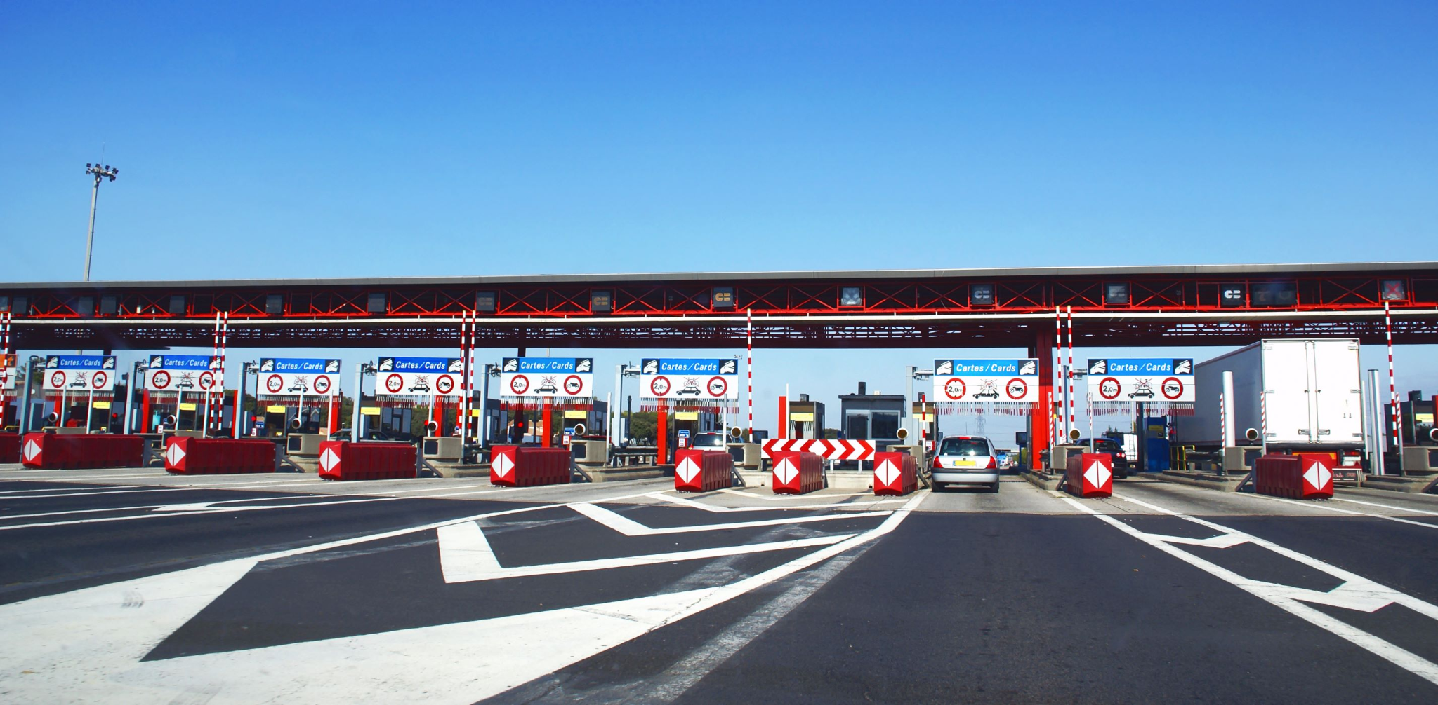
Education Institutions
Bill Easy Platform intends to assist public schools, colleges, and universities operated by government bodies in their billing procedures for tuition and fee collection, as well as other educational services.
Transportation and Toll Authorities
Agencies responsible for toll collection on highways, bridges, and tunnels often rely on billing software to manage toll collection and violations hence are our software will prove to be a boon for them.

Slide 12
BILLS MANAGEMENT
RECURRING
BILLING
CUSTOMER
MANAGEMENT
APPLICATIONS
AUTOMATIC TAX
CALCULATION
GENERATE SALES
REPORT

Slide 13
Team Members
Vasu Sharma -2022UIT3105
Manas Sah- 2022UIT3097
Neha Yadav -2022UIT3117
Ishita -2022UCI8059
Naman Kanwar-2022UIT3113
Muskaan -2023UEC2697

Slide 14

Thank you!

